Slide 1

Online Train Reservation System
This presentation explores the advantages of a modern online train reservation system, offering efficient and user-friendly booking options for travelers.
SK.SHADIK (192210594)
M.MAHENDRA REDDY(192210555)
ss

Slide 2

Importance of Efficient Train Reservations
1
Time-Saving
2
Convenience
Streamlining the booking process allows travelers to save valuable time by eliminating the need for physical visits to ticket offices.
Accessibility from anywhere with an internet connection empowers travelers to make bookings at their convenience, regardless of location.
3
Cost-Effective
Online systems often offer competitive pricing and special deals, making travel more affordable for budget-conscious travelers.

Slide 3
Key Features of the System
User-Friendly Interface
Comprehensive Search
Secure Payment Gateway
A simple and intuitive interface ensures effortless navigation for all users, regardless of their tech proficiency.
Advanced search filters allow travelers to find the ideal train route based on departure and arrival cities, dates, and other preferences.
Secure payment options protect sensitive financial data, offering peace of mind and ensuring secure transactions.

Slide 4
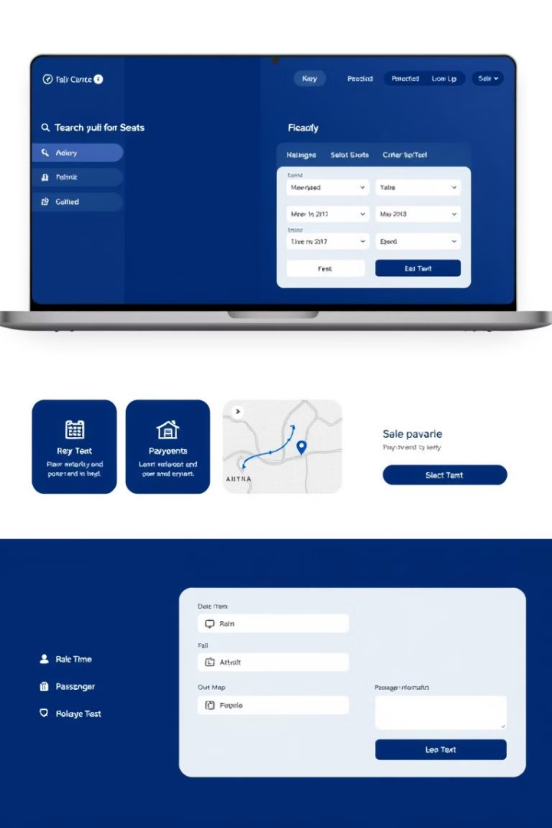
Intuitive User Interface
Clear Navigation
Visual Cues
A straightforward menu structure enables users to quickly access essential features and information.
Intuitive icons and color-coded elements guide users through the booking process, enhancing usability.
Mobile Optimization
Responsive design ensures seamless browsing and booking on various devices, including smartphones and tablets.

Slide 5
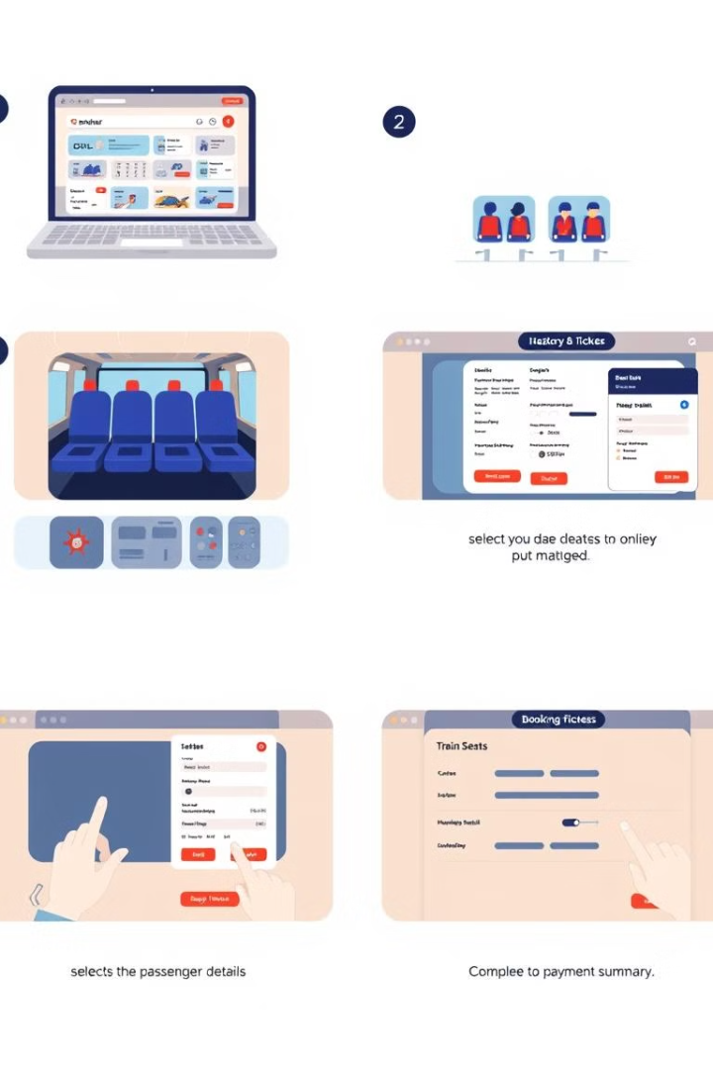



Seamless Booking Process
Search and Selection
Users easily search for available trains based on their desired travel dates and destinations.
Seat Selection
Clear visuals depict available seats, allowing users to choose their preferred location on the train.
Payment and Confirmation
Secure payment options facilitate quick and easy transactions, followed by instant confirmation of the booking.

Slide 6
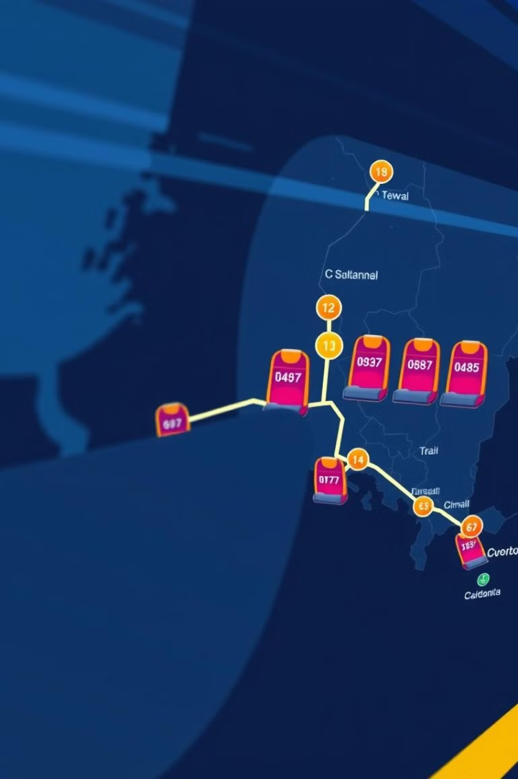
Real-Time Seat Availability
Real-time updates
Accurate seat availability information
Dynamic changes
Reflecting actual occupancy levels in real-time
Eliminates overbooking
Ensures that booked seats are available upon arrival

Slide 7
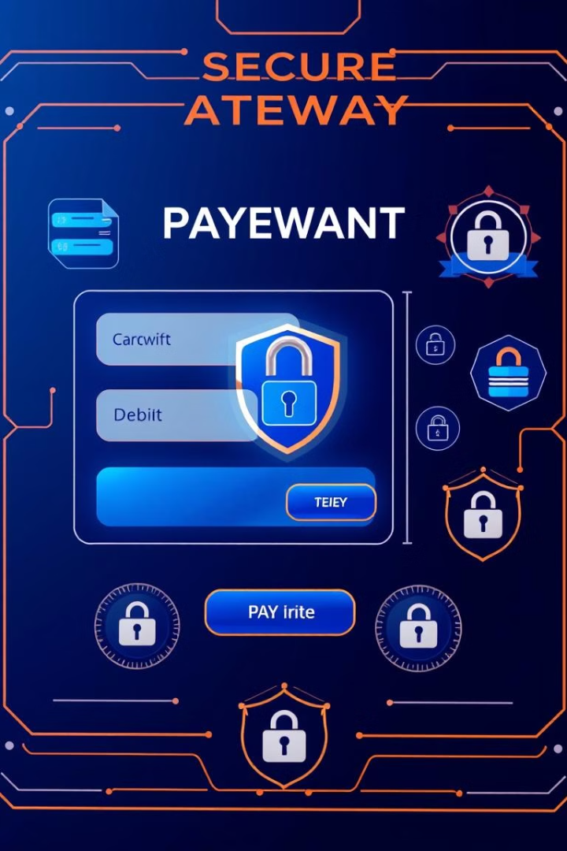



Secure Payment Options
Secure Encrypted Transactions
Protecting sensitive financial information with industry-standard encryption protocols.
Multiple Payment Methods
Offering a variety of payment options, including credit cards, debit cards, and online banking.
Fraud Prevention
Implementing robust fraud detection and prevention measures to ensure safe and secure transactions.

Slide 8

Conclusion and Next Steps
A comprehensive online train reservation system simplifies the booking process, improves efficiency, and offers a range of user-friendly features.

